Slide 1
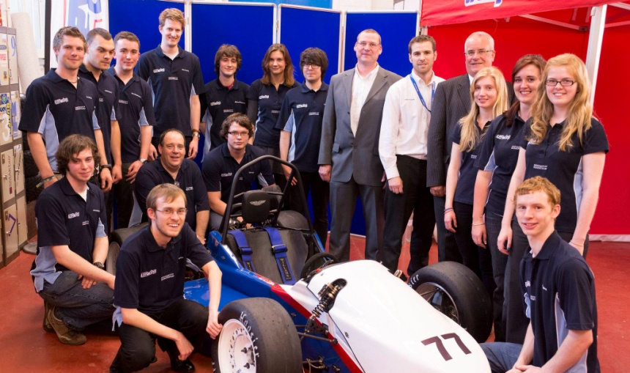
College of Engineering and Physical Sciences
Newsletter — July 2012
Commentary: What a month!
Talking of things racing around circuits at breakneck speed, the UBRacing team have been showing off their latest car, which is due to compete in the upcoming Formula Student competition at the Hockenheim ring in Germany. The team hope to build on their performance at this year’s UK event, and with the support of people from across the College, I’m sure that they can take the top spot on the podium.
There are opportunities for more staff to get involved in this racing competition, and it would be great for the team (and College!) if more people could lend a hand. It’s not just engineers needed, but a whole host of skilled and enthusiastic members are required to nurture a winning team. Read more about this project on page 6.
Chequered flag in sight
Higgs and UBRacing have again shown the excellence of teaching and learning here at the College, and as the academic year draws to a close, I am extremely hopeful for much of the same in 2012–13. Working together, we can ensure that the College of Engineering and Physical Sciences stays in pole position.
Finally, thank you to all who attended the EPS social on July 17. With staff leaving, and fresh personnel to join us in the new academic year, it was good to get together and share a well-earned drink before the summer break.
Quite a month it has been for the College: a great end to a great year. The big news, of course, has been the discovery of the Higgs boson, the illusive particle that our colleagues and friends at CERN have been searching for—a hugely significant moment for science and humanity, and fantastic that the College has been at the forefront of this project.
Professor’s Dave Charlton and Paul Newman, School of Physics and Astronomy, could barely contain their excitement when the news broke: ‘What an amazing day! There's a real sense that we are seeing the start of something really new,’ exclaimed Professor Newman. ‘We're now opening a new chapter of fundamental physics, as the LHC was designed to do,’ added Professor Charlton (read an interview with Professor Paul Newman and Professor Dave Charlton on page 4, and the press release here).
Richard A Williams
Head of College

Slide 2
People news
Staff news
Welcome to:
Mechanical Engineering
Mr Matthew North
Research Associate
Mr Rickie Creegan
Engine Specialist
Mathematics
Dr Ziqin Feng
Marie Curie Research
Fellow
Miss Kathryn Basnett
Teaching Support
Administrator
Physics and Astronomy
Mr Tiago Campante
Research Fellow
Dr Guy Davies
Research Fellow
Awards, grants and appointments
Ms Claudia Marcelloni de Oliveira has been made an Honorary Research Associate. Claudia is the Outreach Officer for ATLAS at CERN, working with Professor Peter Waltkins in the Particle Physics group.
Tom Carey, School of Chemistry (and holder of a Diamond Light Source studentship supervised by Drs Paul Anderson and Joe Hriljac) has won the BZA (British Zeolite Association) Founders’ Award. The award is for UK based postgraduate scientists working in the area of micro and/or mesoporous science. It is aimed to celebrate the best and/or most promising postgraduate scientist of the year.
Dr Bruno Pollet, School of Chemical Engineering, received a £154,131 Research Project Award from the Commission of the European Communities, and Dr Alex Robinson received £105,631 from Irresistible Materials Ltd. for his project, Development of Fullerene Resists for Next Generation Lithography.
Dr Hassan Hemida, School of Civil Engineering, received £37,743 from Network Rail Infrastructure Ltd. for his project, Analysis of a new switch stretch bar design .
Professor Martin Russel, School of EECE, received £632,906 from C.C.H.Q. for his project, Speech Recognition by Synthesis (SRbS).
Professor Hanshan Dong, School of Metallurgy and Materials, received £477,058 from the Engineering and Physical Science Research Council for his project, Stability of Colossally Supersaturated Alloys.
Professor Hongming Xu, School of Mechanical Engineering, received £563,195 from the Engineering and Physical Science Research Council for his project, New Control Methodology for the Next Generation of Engine Management Systems.
Professor Xin Yao, School of Computer Science, received £520,632 from the Engineering and Physical Science Research Council for his project, Evolutionary Computation for Dynamic Optimisation in Network Environments.
Professor Andy Schofield, Head of Physics and Astronomy, received £421,583 from the Science and Technology Facilities Council to fund an Ernest Rutherford Fellowship for Dr Antonio Sergi, concerning the project Development of the NA62 Detector and Search for New Physics with Kaon Decays. Professor Richard Palmer was awarded £207,203 for his project, Super Rate Elemental & Alloy Cluster Technology – SuperREACT.

Slide 3
In the news
In the News
The Ross Barlow
Prof Rex Harris, School of Metallurgy and Materials, his hydrogen powered barge and the ‘Greening the Waterways’ conference were featured in the Guardian’s environment blog. Read here.
Nuclear power
The Telegraph ran an exclusive piece on the report by the Birmingham Policy Commission on the future of the nuclear power in the UK. Read here.
Open access
Adam Tickell, Pro‐Vice‐Chancellor for Research and Knowledge Transfer, was quoted in the Chicago Tribune after the publication of the Government report on open access science publishing. Read here.
China
Professor Richard Williams presented at two media briefings in Beijing and Guangzhou resulting in 35 pieces of coverage on a range of topics from the future of energy storage, the adoption of radical innovations and the University and College’s growing links with Guangzhou. Outlets included China Daily, People’s Daily, Guangzhou Daily, and Xinhua News Agency. Read more about the trip on pages 8–10.
Planets
Prof Bill Chaplin, School of Physics and Astronomy, was involved in the discovery of two Exoplanets found in extremely close proximity. Read more here.
Train speeds that sparkle but don’t pop
Dr Andrew Quinn and Prof Chris Baker, both part of the Birmingham Centre for Railway Research and Education, alongside colleagues from Civil Engineering and EECE, were recently involved in the first test of a Midlands main line train that reached speeds of 125mph. Using risk analysis and pressure recordings, the team hope to remove the popping sound that occurs as the train passes through tunnels on the line. Network Rail and East Midlands Trains Meridian conducted the testing. Read the full article here.
A phone that knows where you are going
Mirco Musolesi featured in an article inTechnology Review about their recent success in the Nokia Mobile Data Challenge. Read the full article here.
The Jamaican’s are on campus
ITV Central ran a four-minute feature about the Jamaican track and field pre-Olympic camp. You can watch the video here.
A green city
The city council’s aspiration for Birmingham to become one of the world’s leading green cities will be spearheaded by a Green Commission, officially launched July 17. Richard Williams will be a member of the commision. Read the full article here.
.

Slide 4
In the news
Higgs boson Q&A
.
With the recent discovery of the Higgs boson, we spoke with two of the leading figures at CERN, our very own Professor Paul Newman, leader of the Birmingham Particle Physics Group, currently working on the ATLAS experiment at CERN, and Professor David Charlton, deputy spokesman for the ATLAS.
NB This is an abridged interview. Click here for the full version.
What does the discovery of the Higgs boson particle means to science?
Paul Newman {PN}: It’s immense: arguably the most important particle physics discovery since the field existed under that name.
Before 4 July 2012, we knew about two fundamentally different types of particle: Matter particles such as electrons and quarks, which are the basic building blocks of everything in the Universe, and particles such as photons, which are responsible for the forces which act between the matter particles. The Higgs boson fits into neither category—it adds a third classification of elementary particle to our understanding of nature.
Dave Charlton {DC}: The underlying structure and forces of nature are described in terms of particles carrying forces (the photon, W and Z bosons, and gluons in the strangle language of particle physics) and the particles which make up matter (called leptons and quarks – these make up “everyday” atoms, molecules, you me and everyday objects).
The theory which describes all of this is known,
somewhat modestly, as the “Standard Model.”
The new particle we have observed, if it is the Higgs boson, is a new type of fundamental particle, different from all the ones we have found before. The Higgs boson differs from all the others in that it has no spin.
The role of the Higgs boson in the Standard Model is that it corresponds to a field that pervades all of space, giving rise to the masses of particles – an analogy is that it is like a kind of cosmic syrup which slows particles down (heavy particles are harder to accelerate in the syrup) – though as with all analogies this is not quite the full story. The Higgs mechanism – the existence of the “syrup” as a modelling tool, and the existence of a corresponding particle, the Higgs boson, was postulated in the early 1960's, and it has been an open question ever since whether the explanation of mass is correct. With the observation of this new particle, we are closer to knowing the answer.
So in summary this is a big step because we believe we are opening up a new area of exploration and study, of the structure of space-time – or the vacuum – itself.
continues on next page

Slide 5
In the news
Higgs boson Q&A, continued
Some put the cost of the LHC at around $10billion—was it all it worth it?
PN: When you place that headline cost in the context of a world-funded project over 20 or more years, it no longer looks quite so staggering, but yes, it’s expensive on the scale of science funding and requires justification. I think it’s worth it for all sorts of reasons…
At a cultural level, mankind has discovered something fundamental about how the Universe
works, which adds to the sum total of our achievement and understanding and can never be undiscovered.
Then there are the spin-off bene-
fits. It’s common knowledge that
the World Wide Web was invent-
ed at CERN, but there are many
Other examples in computing,
electronics, medicine and various
other fields of developments which
relied on technology developed at
or for CERN and the LHC. Just to
give one example, did you know that touch screen controls were invented to ease the operation of a previous CERN accelerator?
DC: Everyone is entitled make their own judgement of this: it IS expensive to do this sort of science, and this is precisely why it is a global endeavour sharing the cost, and excitement, across all continents and many countries. It is great to see that the excitement is shared all around the world, and that we help in a small way to improve understanding of the scientific method – namely that we do not know the answers to big questions, but we want to find them out. This is how the knowledge of humanity progresses.
How do you think history will remember this discovery?
PN: It’s certainly seminal in the history of particle physics. The physics text books will see it as the last piece in a jigsaw, confirming a set of ideas on how the Universe works, the Standard Model.
Future experimental developments in the field will be guided to a large extent by this discovery. A whole new sector of particle physics has now been opened up, which will be explored for a long time to come.
DC: This is for the historians, not me! But I agree, this starts a new chapter in the textbooks.
What does it mean for the College?
PN: The ATLAS experiment is a collaboration of over 3,000 scientists from all over the world
and it’s important to stress that the credit for this discovery is shared by all of them.
The Birmingham group contributed
substantially to the analysis of the
data in the search for the Higgs
boson. It’s produced in only around
one in 10 billion collisions and is
buried underneath huge
backgrounds from other
processes, so digging it out has
required cutting edge analysis techniques and every scrap of ingenuity we could muster.
DC: The university can feel proud that Birmingham has a key role in the ATLAS Collaboration, having led and built crucial parts of the trigger system which ensures that the right events are collected from the proton-proton collisions. The University and College can feel proud that Birmingham has a key role.
How did you celebrate?
DC: A bottle or two of champagne might have been opened... However, the highest priority for many of us was simply to get a few good nights of sleep!
PN: The first thing I wanted to do was sleep too! So I can’t say I’ve really had much chance to celebrate yet, but I might see you in the bar later!
If that’s not enough, watch the Telegraph’s video here, listen to ABC Australia interview here, and read the Mail’s take on things here.
.
“
The University & College can feel proud that Birmingham has a key role.
”

Slide 6
In the news
Formula student
Students and staff from the School of Mechanical Engineering recently unveiled a racing car that has been in development for many months, for an international competition the School has been involved in for the past 15 years (although they have been building cars for much longer than that).
Formula Student UK, a design competition in which University teams from across the world build and race cars, showcases the skill and innovation of our young engineers in a real-world environment. The competition, organised by the Institution of Mechanical Engineers, has garnered considerable international standing; the motorsport industry considers success at this competition to be the benchmark for graduate entry into this highly competitive and lucrative industry. Student teams, backed by industry, academics and sponsors, spend months designing, testing and building their cars, to ultimately race them at Silverstone course in July.
The University is heavily involved in the competition, and students from our College have entered every year, and are improving year-on-year. A number of prizes have already been collected, including first places in cost and acceleration, and a highest overall rank of eighth. This year’s 25-strong team, led by student Amy Collin (now on industrial placement with Jaguar Land Rover and expected to complete her MEng degree in 2013), hope to improve on earlier successes.
This real-world learning experience provides students with a fantastic opportunity to put into practice the skills gained from Birmingham. The School of Mechanical Engineering lends its support to the competition, and the team’s success over the years highlights the School’s teaching and research excellence.
And it’s not just current students who are involved: some 400 alumni, many of whom have subsequently gone into the industry, continue to support the Birmingham entries. Not only does it provide a great networking experience, building the essential relationships and connections required for successful graduate entry to the workplace, but it also means the cars are getting faster, safer, cleaner, easier to handle , and closer to the chequered flag.
This year’s UK event at Silverstone started well with the car speeding through scrutineering. UBRacing were the twelfth team through resulting in a full day on Friday to prepare the car for the dynamic events over the weekend for the race engineers, while others prepared for the business presentation, cost and design events. Saturday morning brought some torrential rain and testing conditions for both the acceleration and autocross events, while the team were once again thwarted by an oil spill on the skidpan track. A tough weekend of luck was capped with a mechanical failure just four laps from the end of endurance. The team finished in 43rd position out of 115, which was an improvement on last year’s UK competition and but for some dreadful luck could have been much higher. There were of course, many positives from Silverstone and with some hard work between now and FSG we’ll be ready to take on the world again. Bring on the Germans!
Get involved
Formula Student has a
number of high profile
partners, including
Jaguar Land Rover,
Airbus, and Mercedes
AMG, who are looking
to the next generation
of highly-trained and
experienced graduates
to fill their ranks.
Designing and building a car is an expensive business (each year tens of thousands of pounds), and the students are fortunate to have some fantastic sponsors who contribute not just money, but also experience and ideas. These include Yamazaki Mazak UK, Perkins Engines, and Iscar Tools, and graduates that have been involved in UBRacing have gone into careers with Rolls Royce, Jaguar Landrover, and a number of Formula 1 teams. Individuals interested in funding the project can find out more here.
Birmingham staff Carl Hingley (x 44218), Senior Technician and Team Manager of UBRacing, and Dr Karl Dearn (x 44190), Faculty Advisor, currently support the team’s efforts, although there is potential for more staff to be involved. If you have an interest in racing cars, or background knowledge in a relevant field, then please get in touch.
.

Slide 7
College News
Universitas 21 awards
The College has had another great year, and scooped a number of the Universitas 21 awards.
University of Birmingham Undergraduate Travel Bursaries
These are awards worth £1,000 each are open to UoB students to support their year abroad at U21 partners.
Eleanor Holden, School of Physics, UNSW
Rachel London, School of Chemistry, UNSW
UoB U21 Summer School Awards
This year we were able to offer a number of new undergraduate U21 Summer School awards, as well providing awards to support attendance at the official U21 events the Undergraduate Research Conference at Waseda, and the Summer School at Monterrey.
Phoebe Mau, 2nd year Mathematics, Monterrey, Mexico U21 Summer School
Benjamin Giblin, 1st year Physics and Astronomy, Waseda, Japan U21 UG Research Conference
U21 Staff Fellowships
The Fellowship programme aims to facilitate the transfer of knowledge and skills within the network and encourage the sharing of best practice. It is designed to provide support to Birmingham staff who have demonstrated innovation and excellence in their field and who are likely to benefit from an extended period of professional development which, in turn, will benefit the University.
Applications doubled from 2011 and 6 U21 Staff fellowships were awarded for 2012–13. The selection panel was chaired by Peter Byers and included Andrea Edwards from International Relations, Henry Chapman from CAL and Anna Phillips from LES.
Constantinous Constantinou, School of EECE, Bridging the knowledge and skills gap between taught and Doctoral programmes in the field of wireless communications, Auckland.
Sharon Stephen, School of Mathematics, Equality and Diversity for Academics in Higher Education, UNSW
U21 PhD Scholarships 2012–13
The PhD Scholarships are to enable students to spend up to three months at a U21 partner institution. Applications increased by a third from 2011 and awards have been made to the following students:
Alex Upton, School of EECE, Auckland
Congxiao Zhao, School of Civil Engineering, HKU
Felix Rehern, School of Mathematics, Auckland
Naomi Green, School of Mechanical Engineering, Dublin
Sarah Baker, School of Metallurgy and Metals, Lund.
£19,000 was awarded for PhD Scholarships this year including a donation from the Graduate School enabling three more Scholarships to be awarded. Applications will reopen for the following year in October 2012.
U21 Early Career Researcher Workshop
Shanghai Jiao Tong University, 4–6 December.
Theme: The status-quo and the future of Ecological Civilization
The survival and development of humankind have been increasingly threatened by ecological
crisis triggered by environmental pollution, global warming, ecological deterioration, resource
exhaustion, and more. To tackle the severe challenges faced by humanity and to remedy all the ills and defects brought about by industrial civilization, a new concept, namely ecological civilization has come into being.
How to define “ecological civilization” and how to do research in this area has become an urgent
issue for scholars in various academic fields worldwide. At present, several young researchers
from the School of Humanities of Shanghai Jiao Tong University are collecting relevant data and
work on the topic of ecological civilization in terms of its definition, origin, evolution, values,
political systems, practices and evaluation system.
Find out more here.
The

Slide 8
College News
Guangzhou
The first of many trips East
Dr Moataz Attallah, Lecturer in Advanced Materials Processing, School of Metallurgy and Materials, was a part of the 8-strong team to have visited Guangzhou, China, last month. We spoke with Moataz to get his perspective on the College’s recent inroads into the world’s most populace, and booming, nation.
What can be gained from engaging with China?
For starters, we can bring in considerable research income from China. But that’s not the main reason to engage, we want our academics involved in China because it is the right time to be there. Academics can increase research power; one group in Birmingham can work together with one in China, or establish another group in China, therefore increasing our research power and income.
What unique features does China provide for hosting joint initiatives?
This is an interesting period in China’s history; there is a booming industry, and the municipal governments are identifying their research priorities. Whereas in the UK the priorities are on health and security, in China it’s more about making the Chinese industry more environmentally friendly, focused on low emissions. This is the first time China has had these national priorities, and we can help with the transformation.
Also, there is rapid growth, with more than one funding opportunities available with foreign partners. I encourage academics to apply: municipal governments have budgets, industry is joining in, and there is plenty of investment. Birmingham has a strong connection to China, with a large number of students and staff, so partnership between us and Guangzhou could be rife—it’s ideal to invest in.
What funding opportunities are available for academics keen to engage in collaborative research?
Well, there are many. Firstly, there are the joint funding calls between the EU and China in a number of areas. The School of Metallurgy and Materials currently leads a joint EU-China project on Casting of Large Titanium Structures (COLTS).
continues on next page

Slide 9
College News
Guangzhou: The first of many trips East (continued)
In this project, a number of EU and Chinese universities, companies and research centres work together in a consortium. This project has brought an income of £0.5 M to the university. There are joint calls within the last FP7 call and will definitely be in the Horizon 2020. It’s an example of the Chinese government and EU working together.
Secondly, there is the Marie Curie programme. Visiting researchers from China can bring in talent and knowledge transfer through this mobility scheme. Researchers are moving, spreading their level of influence and engagement.
The final funding source is through the municipal governments, together with the Chinese industrial and academic partners. Funding from the municipal government is on the rise, with up to £0.5m available. This can be applied for by universities, or industrial partners.
What did you get up to during the trip?
Well on day 1 we visited the Guangzhou Centre of Industrial Technology (GZIIT), where we discussed applied research and spoke about technologies. On the second day we hosted some workshops with local businesses and universities. Day 3, we visited a company, and research centre. Day 4, the GZIIT again, and for good reason: The centre’s research activity is comparable to four or five universities in the UK. The amount and scale is enormous. Although the technology is not the most up-to-date, maybe 5 years behind us, it does have some great equipment.
We proposed some ideas for joint research that we can work together with them. It’s all about maximising our research power, utilising their man power, with a level of flexibility on what you can try—it’s a very exciting place to be right now.
What were some of the more positive agreements reached during the recent trip?
The Guangzhou Centre of Industrial Technology was a highlight. We identified 10 topics from our presentation, talked about working on a number of them. They have some excellent researchers, and I’m looking forward to working with them in the future.
And I must say that we got and continue to receive enormous help from Vivian and Lily in our Guangzhou office. They followed up with additional meetings, and we are hopeful things will move on. For example, a researcher applied for the Marie Curie scholarship, and we hope to be working together soon.
Finally, could you describe your impression of the city and the facilities you visited?
This was my first time in China, and I was impressed with the level of sophistication. To be honest, I can’t see a massive difference between Japan and China. The meeting rooms were impressive, and the people incredibly accommodating.
In the city, there were big Tesco supermarkets, Carrefour, 7/11s. The streets are developed, and the universities and research centres are well-developed. As a student, my perception of China was one of a socialist-communist country. But what I saw was totally different; semi-capitalism, and very successful, it’s an interesting political model. And Cantonese food is more than acceptable!

Slide 10
College News
Some background to Guangzhou
Guangzhou, capital of Guangdong Province, is the third largest municipal economy in China. Located on the northern edge of the Pearl River Delta and adjacent to Hong Kong, Macao and the South China Sea, Guangzhou is known as the ‘Southern Gateway to China’ and a major logistics, transportation and communication hub.
The metropolitan area covers 7,434 square kilometres, with a population of over 10 million and floating migrant population of several million more. The city enjoys a sub-tropical monsoon climate with an average annual temperature of 20–22°C and plenty of rainfall. With various colourful flowers blooming all the year round, Guangzhou styles itself a ‘City of Flowers’.
Guangzhou is a city with a long history of over 2,200 years and great cultural heritage. As the starting point of the ancient ‘Marine Silk Road’, Guangzhou has been recognized as a globally important port for the last thousand years. It is presently centre for international trade and economic cooperation in South China. The Chinese Export Commodities Fair has been held biannually in Guangzhou since 1957. The city's overall economic power ranks the 3rd in China. In 2010, Guangzhou GDP reached 1.06 trillion yuan—an increase of 13 percent year-on-year. It contributes 2.7% of national GDP. Annual per capita GDP is estimated at more than 100,000 yuan (£10,000).
Guangzhou is the education cluster of South China with over 25 universities with about 1million students. The leading universities include Sun Yet Sen University and South China University of Technologies, ranking the 18th and 30th nationally. In order to encourage development of education sector and provide better infrastructure, Guangzhou government invested 20bn yuan to build a university city of 43.3sq.km, accommodating about 300,000 students.
Foreign universities have been increasingly active in Guangzhou, including University of Lancaster (UK) establishing a joint campus with Guangdong University of Foreign Studies and Carnegie Mellon (US ) establishing a joint school with SYS. Guangzhou Municipal government welcomes international co-operations in education, as well as research collaboration. It is estimated that Guangzhou’s total investment in research and development is about 2.5% of its GDP, ranking top ten in China. Eleven national key research institutes and twelve national R & D Centres of Engineering are located in Guangzhou including Guangzhou Institute of Biomedicine and Health (CAS), Guangzhou Institute of Geochemistry (CAS), and South China Sea Institute of Oceanology (CAS). Guangzhou’s 12th Five Year Plan highlighted that the city should build its economy on research and innovation.

Slide 11
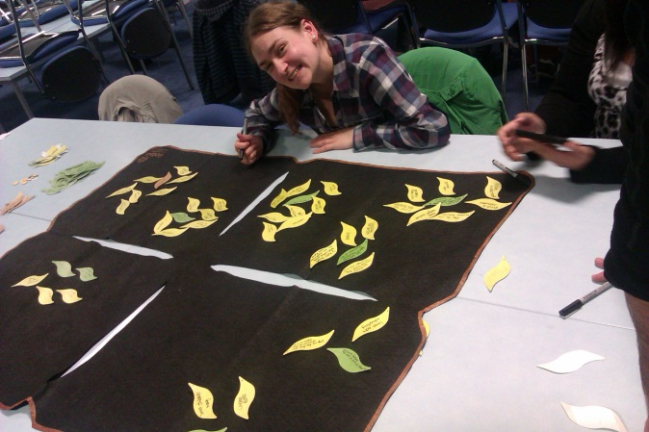
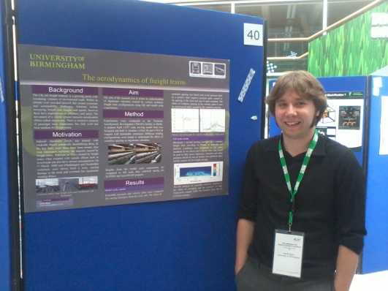
College News
EPS Grand Challenge off to a great start!
On Monday 18 June, a full cohort of students from the universities of Birmingham and Aston came together for the first time, ready to take on 2012’s Grand Challenge.
Throughout the week the group of 47 was allocated into six teams, ready to take on the challenges issued by IBM and Atkins, surrounding Birmingham issues, and supported by Birmingham City Council and Birmingham Science Park. Before starting their projects proper, the students had workshops on team building, leadership, problem solving and decision making, multi-faceted optimisation, communication skills, project and time management, intellectual property and creativity and innovation. Armed with these new-found (or newly-reinforced) skills, the teams developed their ideas and presented them on Friday 13 July.
Jenny Illingsworth, Grand Challenge coordinator and module leader, commented; “There is so much energy; the students are raring to go and have gelled into their teams really well. They’re wonderfully enthusiastic and the mixture of Aston and Birmingham students gives an even better
Rebecca Brenon, BSc Maths graduand, enjoying
the Creativity & Innovation ideas-generation
workshop on Friday 22 June.
variety and outlook than we could have expected. I can’t wait to see how their ideas develop over the next three weeks.”
For more information on Grand Challenge, please contact Jenny Illingsworth, Assistant Regional Director, HE STEM Programme Midlands & East Anglia, on j.s.illingsworth@bham.ac.uk or 0121 414 4165.
Research Poster Conference—the results!
Runner up: David Ryan Measuring cavitation onset in a Sonolator
1st place prize: David Soper
The aerodynamics of freight trains
Overall winner: Emily Owen Bumblebees: Cold Tolerance and Impacts of Diet
The winning posters can be found here.
Birmingham Brief Competition
Entrants to the Research Poster Conference could also enter the Birmingham Brief competition for a chance for their abstract to be published on the University of Birmingham web site.
The College winners were David Infante Sanchez, Amrit Chandan, and Maryam Najafian.
Above: David Soper next to his winning poster.

Slide 12
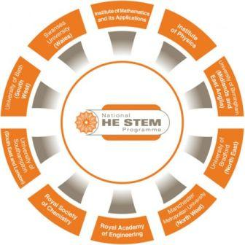
College News
National HE STEM Programme Conference
On the 4–6 September, the National HE STEM Programme, a £21million, 3-year initiative established by the Higher Education Funding Councils for England and Wales, will hold a major conference showcasing and disseminating the learning from its work within England and Wales.
Confirmed Keynote speakers include:
• The Rt Hon David Willetts MP (Minister of State for Universities and Science).
• Lord Robert Winston (Professor of Science and Society and Emeritus Professor of Fertility Studies at Imperial College, Author, Science Broadcaster, and Politician)
• Sir Alan Langlands (Chief Executive of the Higher Education Funding Council for England).
The National HE STEM Programme, which commenced its work in August 2009, has undertaken a series of activities, projects and interventions that have been designed to enhance the way universities recruit students and deliver programmes of study within the Science, Technology, Engineering and Mathematics disciplines. At its heart has been a focus upon increasing and widening participation within UK higher education from traditionally underrepresented groups of learners.
The conference will contain over 130 presentations from those who have lead the work of the Programme which has taken place within almost 90
higher education institutions across England and Wales and across three specific themes:
1. Widening participation within the STEM disciplines at university level, by supporting HEIs to work with those currently within the school, college and FE sectors;
2. Higher Education curriculum developments focusing upon course delivery and design, student support, to enhance student knowledge, progression and skills;
3. Encouraging those currently within the workforce and society without a prior university-level qualification to engage with further study to develop enhanced knowledge and skills.
Details of the activities that have been undertaken as part of each theme can be found here. A comprehensive poster display will also be available throughout the conference.
The conference will be particularly relevant to anyone within higher education looking to enhance their existing activities or develop new approaches, or for those from the school, college, further education, or employment sectors looking to engage more effectively with higher education. Participation in the conference represents an ideal opportunity to learn from the practices and approaches that have been developed, to network with like-minded individuals to share information and ideas, and develop future collaborations.
Free to all individuals involved in UK higher education activity and competitive rates for those outside of the UK (advance registration essential).
To guarantee your place at the conference, you are strongly encouraged to register. Please register as soon as possible by clicking here. For further information, including details of how to register and a full conference timetable, please visit http://www.hestem.ac.uk/conference.

Slide 13
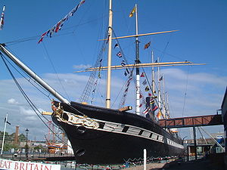
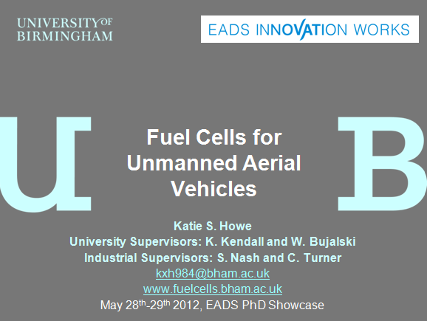
Student News
EADS PhD showcase
Miss Katie Howe is a third year PhD student in the School of Chemical Engineering currently looking at the use of solid oxide fuel cells to power small unmanned aircraft. Katie’s PhD is being conducted in the Doctoral Training Centre in the Centre for Hydrogen and Fuel Cell Research here at the University, and is sponsored by EADS Innovation Works; a global network of Technical Capability Centres. In addition to a personal stipend, this sponsorship provides extra funds for laboratory equipment and consumables or travel to conferences, as well as providing the opportunity to experience working with a large company.
On May 28–29, EADS Innovation Works organised a PhD showcase mini-conference, with all sponsored PhD students (over 60 participants) being invited to give a presentation or poster on their work. Keynote speakers from various sections of EADS also gave presentations, including the Head of EADS IW, Yann Barbaux, who gave an overview of the company and activities of the various sectors.
Katie proved to be a very worthy competitor and won the Best Presentation award for her talk, Fuel Cells for Unmanned Aerial Vehicles, which discussed the advantage of using more “green” and efficient power systems in the form of fuel cells that can hugely extend the flight time of unmanned aircraft as compared to battery power. The prize is tickets to the Farnborough air show.
“I am very pleased for Katie to have won this competition and it came as not a big surprise to me. I see it as just reward of her efforts and diligent work to date on the DTC PhD programme and I’m sure EADS if of a similar opinion knowing that their financial support for Katie is bearing some fruits!” said Waldek.
The presentations aimed to show how the research undertaken by sponsored students could be useful to EADS, and which business unit would benefit. For example, Katie’s work on fuel cells for unmanned aircraft would be most useful to Cassidian, as they produce these aircraft, and would offer a strong competitive advantage due to the customer benefits of the change of power system. Quite a few EADS employees were present throughout the two-day event to talk about their areas of research and expertise, and what it is like to work for EADS. The student participants were given tours of various parts of the Airbus site in Filton, and they were also invited for dinner onboard the SS Great Britain on the first night of the showcase. Overall, it was a great event, giving students from different but related backgrounds the chance to exchange ideas and an insight into what it would be like working for EADS.
Dr Waldemar Bujalski, senior research fellow at the School of Chemical Engineering, is Katie’s primary supervisor, and Mrs Caroline Turner is her Industrial co-supervisor. Katie would like to acknowledge the financial support from EADS IW and also the expert help and guidance she has received.

Slide 14
Student News
Entries are now be accepted for the 2012 SET Awards.
Entry costs nothing, and if your student is shortlisted it can bring wide recognition and publicity for your teaching and your university.
There is a wide range of categories and most disciplines are covered. If any of your students have completed an exceptional project, they can be entered.
The Awards are presented at a dinner and ceremony before an audience comprising hundreds of technology students, academics, senior industry executives; as well as senior figures from government, scientific and technical institutions and the media. This year's ceremony will take place at Kensington Town Hall on the evening of 26 September.
Entering is a simple 'point and click' process via the awards website:
http://www.setawards.org/about/europe. Please make sure that you read the Rules section before entering a student. We close for entries on 30th July 2012.
The SET Awards, now in their fifteenth year, are Europe's leading awards for science and engineering undergraduates. The presentation ceremony brings together academics from universities across Europe. It has long been an important networking event, as well as a celebration of the best undergraduate teaching.
At the request of many academics, we have added a conference, SET-TALK 2012, which will take place during this year's SET Awards.
There has rarely been a time when so many crucial issues have affected
universities: changes to undergraduate funding, problems with post graduate funding, allegations of "grade inflation", restrictions on patents, and a host of others.
Some of Europe's leading academics will be speaking on these topics, and we very much hope you will be able to attend. For details go to:
http://eurovent.co/conferences-event.php?eid=212.

Slide 15
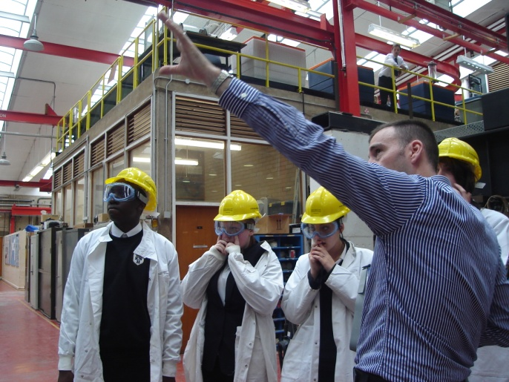
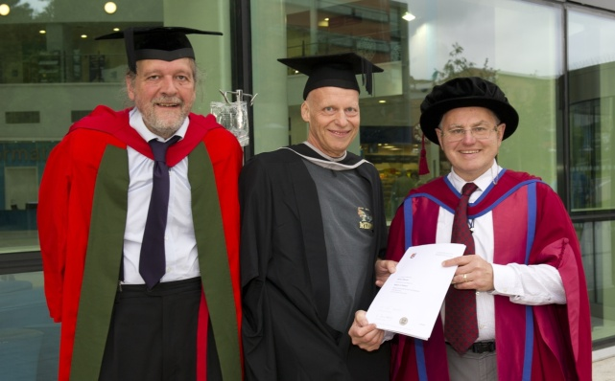
School News
Civil Engineering
Civil Engineering staff take ‘Graduation Ceremony’ to QE Hospital
On 10 July 2012, Prof Felix Schmid and Dr Charles Watson from the School of Civil Engineering walked to the new Queen Elizabeth II Hospital to hand over the Degree certificate to David Oldroyd whose award had been announced at the EPS graduation ceremony earlier that day. David graduated from the MSc programme in Railway Systems Engineering and Integration, achieving a distinction. He was also awarded the Balfour Beatty prize for the best technology oriented dissertation. Mr Oldroyd, a senior railway infrastructure engineer, had been called to the Hospital at short notice to continue a course of treatment, with a space becoming available on the day of his graduation. Joy Grey, the administrator of the MSc, took the commemorative photo and David’s wife Celia and Andreas Hoffrichter, another of the day’s graduates, provided the appreciative audience.
David had combined part-time studies at the University with full-time work on a number of high profile international railway projects. He finished the programme in less than two years, thanks to a high level of commitment and hard work.
Budding Civil Engineers design high rise buildings
As part of the School of Civil Engineering’s outreach and impact activities, a group of year 9 pupils (~14 years old) from Kings Norton High School (KNHS) visited the University. Their remit was to design a 1:200 scale model of the Hyatt hotel which was capable of supporting a 10N load at the top of the building and resisting a horizontal wind load of ~2N. The pupils were divided into small groups, given 14 sheets of A4 paper, some sellotape and after two hours produced some very credible designs.
Two of the four buildings exceeded the design criteria with one group producing a remarkably efficient design. Mark Sterling stated; “I was pleasantly surprised by not only the ingenuity of the designs but also the way in which each pupil was fully engaged with the process…they are a credit to their School.”
Dr Gerrard (Head of the faculty of Maths and Science, KNHS) was also supportive of the event, stating; “It is not often that learners of this age get to interact with leading experts in the field of Wind Engineering. It is clear that they have not only thoroughly enjoyed themselves but have learnt a great deal. The learners were very much looking forward to this day and I am sure they will continue to talk about it for a long time.”
David is shown with Charles Watson (Teaching Fellow in Railway Systems Engineering, left) and Felix Schmid (Professor of Railway Systems Engineering, right).

Slide 16
School News
Chemistry
Best day at school, ever!
Staff and students from the School of Chemistry sparked the imagination of school pupils in late June with practical demonstrations at ‘The Big Bang’ West Midlands, co-organised by the University.
Hosted at the Thinktank, Millenium Point, The Big Bang: UK Young Scientists and Engineers Fair offered young people the opportunity to experience hands-on learning in an informal environment outside the classroom. The fair encouraged enquiry-based learning and stimulated interest in science, technology, engineering and maths in addition to offering an insight into future careers in the local area and beyond.
Many teachers also found the event a great source of inspiration for lessons and were able to pick up ideas and resources. The best quote of the day came from two schoolgirls making ‘elephant’s toothpaste’ who exclaimed “this is the best day at school ever!”
College Calendar
Other dates
September
Tuesday 4: National HE STEM day
Wednesday 5: Graduate Careers Intensive
Saturday 8: UG Open Day
Friday 14: 100 Years of Chemical Engineering
Tuesday 18: College Board
Monday 24: Start of Autumn term
Monday 24: Distinguished Leaders Speakers Series:
Ian Lobley
College Committees
September
Wednesday 19: Education

Slide 17
College life
College opportunities
EE2012
The International Conference on Innovation, Practice and Research in Engineering Education 2012 will be held 18–20 September at Coventry University. EE2012 is dedicated to enhancing the quality of higher education in all engineering disciplines. It will serve as a forum for sharing innovation and effective practice and will provide delegates with the opportunity to critically and creatively engage with new ideas and research.
Keynote speakers include Professor David Radcliffe, Purdue University; Professor Julia King, Vice-Chancellor Aston University; Professor Matthew Harrison, Director of Education, Royal Academy of Engineering; and Professor Helen Atkinson, University of Leicester, President of EPC. Click here for more details.
Science and Innovation Network
The UK’s Science and Innovation Network in Canada would like to announce the launch of our new Collaboration Development Award (CDA) program!
This program aims to foster bilateral (Canada/UK) relationships in priority areas, building on existing agreements/relationships such as the Canada/UK Joint Declaration, Joint Innovation Statement, and Polar Research MoU.
We will be offering 8 awards, valued at £1250 each, so scientists, engineers, academic leaders and innovation experts can travel abroad for short visits to lay the groundwork for collaborative efforts.
Deadline for applications is September 1, 2012. Please see the website for details and application form.
Engineering and Physical Sciences Research Council
The Engineering and Physical Sciences Research Council invites applications for its visiting researchers grants. These enable research scientists and engineers of acknowledged standing to visit a UK research organisation. The visiting researcher can be from anywhere in the world, including the UK.
Applications must be submitted by the host UK research organisation. Grants are for a period of up to 12 months and cover salary costs, travel and subsistence. The researcher can make one long visit or a series of shorter visits within the 12-month period. Click here for more details.
European Research Council Grants 2013
The European Research council has just published the following calls:
ERC Starting Grant, deadline 17 October, and the ERC Advanced Grant, deadline 22 November.
You can now download the Guide for Applicants and the Work Programme using the links above. Please read the guide carefully as there are some key changes to the proposal from previous years. If you have any questions, or require further information, please contact Branwen Hide (x48642) in Research & Commercial Services.
Contact
If you have any suggestions for College Newsletter or intranet content ,or if you would like to be added as a contributor for future updates, please contact Liam Singleton, Internal Communications Officer at l.singleton@bham.ac.uk

