Slide 1
Particle Physics
J1 Particles and Interactions

Slide 2
Particle Physics
Description and classification
State what is meant by an elementary particle (no internal structure)
Identify elementary particles (quarks, leptons and exchange particles, Higgs?)
Describe particles in terms of mass and various quantum numbers (mass, charge, spin, strangeness, colour, lepton number and baryon number)
Classify particles according to spin
State what is meant by an antiparticle
State the Pauli exclusion principle
Fundamental interactions
List the fundamental interactions (note electro-weak)
Describe the interactions in terms of exchange particles
Discuss the uncertainty principle in terms of particle creation

Slide 3
Particle Physics - No
What is the universe made of?
Brainstorm, starting with those not so familiar
Elementary particles – What are they?
Have no internal structure
Consist of three distinct families
What are they? – Quarks, leptons, bosons
How do we know? CERN Presentation

Slide 4
Particle Physics
Particle classification
Leptons (light)
Hadrons (heavy)
Mesons
Baryons
Gauge (exchange) bosons
Higgs?

Slide 5
Particle Physics
Leptons

Slide 6
Particle Physics
6 Leptons
 |  | Mass (GeV/c²) | Electric Charge (e)
 | electron neutrino | <7 x 10-9 | 0
 | electron | 0.000511 | -1
 | muon neutrino | <0.0003 | 0
 | muon (mu-minus) | 0.106 | -1
 | tau neutrino | <0.03 | 0
 | tau (tau-minus) | 1.7771 | -1

Slide 7
Particle Physics
Leptons + antiparticles gives 12! Or more?
The positron was postulated by Dirac in 1928 resulting from a relativistic solution to Schrödinger's equation
And found by Anderson in cosmic rays in 1932 (asymmetry)
Anti-particles have opposite charge (and all other opposite quantum numbers)
Bosons are their own anti-particles

Slide 8
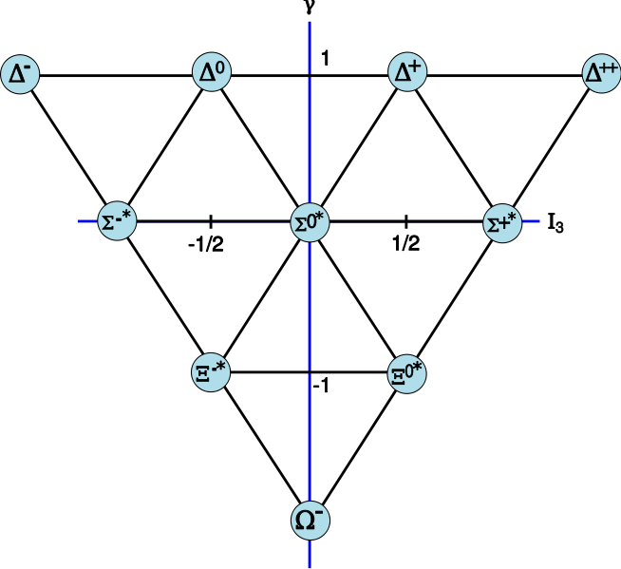
Particle Physics
Hadrons – Mesons (middle) and Baryons
More than 150 discovered (cf PT)
Particle accelerators and cosmic rays
All, apart from the proton, are unstable, half lives running from 10⁻¹⁰s to 10⁻²⁴s
Unlike Leptons they have measureable size

Slide 9
Particle Physics - No
Good news!!
Hadrons are not elementary particles, they have internal structure
The are composite particles

Slide 10
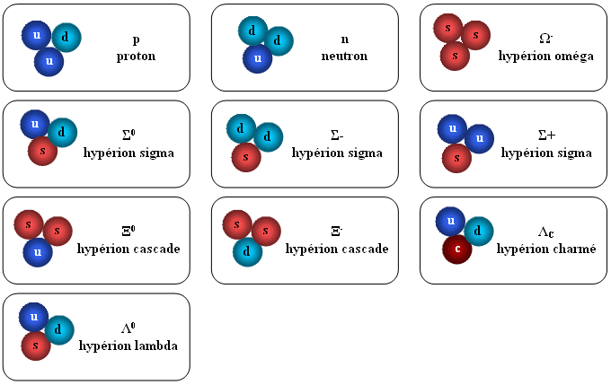
Particle Physics
Hadrons, are made of quarks! (source)

Slide 11
Particle Physics
Mesons (2 quark and anti-quark) baryons (3 quarks) ? (5 quarks)
Quarks! (6 + 6 anti-quarks! )

Slide 12
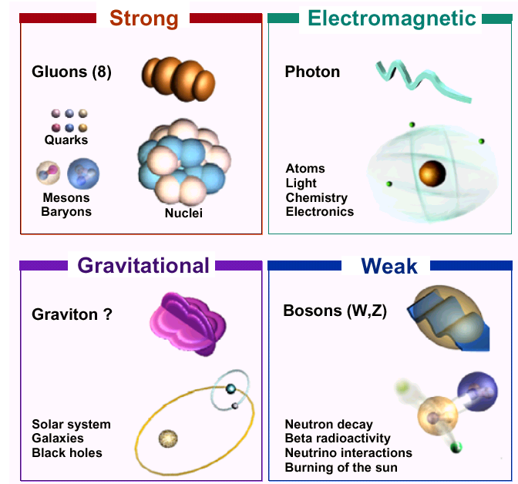
Particle Physics
Gauge Bosons, are related to the fundamental forces
Virtual
HUP

Slide 13
Probing deep into matter
The Standard Model
The result of many years of particle research is that all of the particles we observe can be explained through the standard model.
All forces are carried by Bosons.
Matter is classified in these families:
Fermions
Leptons
Baryons
Mesons
Hadrons

Slide 14
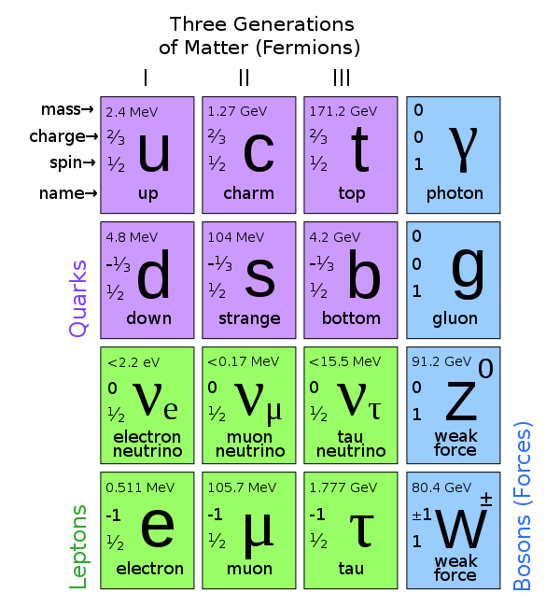
Probing deep into matter
The Standard Model
All baryons are made up of quarks, and there are three generations of quarks and leptons.
Additionally there may be the graviton and the Higgs.

Slide 15
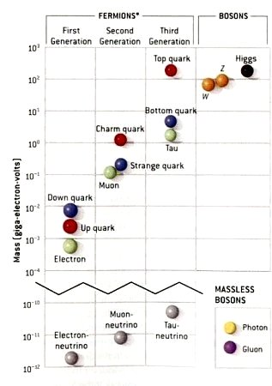
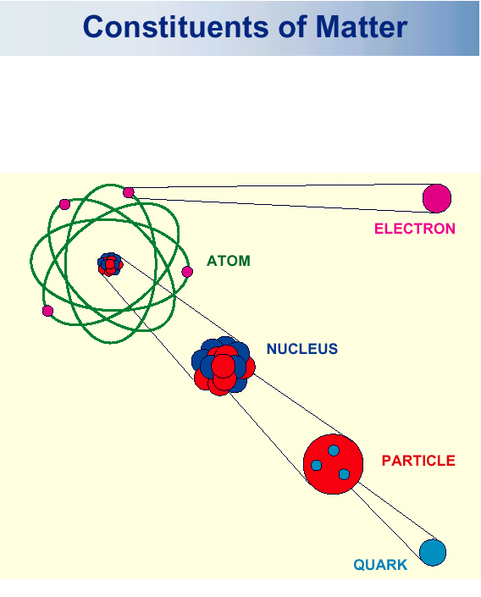
Particle Physics
So have we simplified it or not? 12+12+13

Slide 16
Particle Physics
Quantum numbers –
Numbers (or properties), with discrete values, which are used to characterise particles.
Each elementary particle is described in terms of its mass and various quantum numbers.
The quantum numbers relate to properties which have certain discrete values (quantised)
Some of these properties are electric charge, spin, strangeness, colour, Lepton number and baryon number
Quarks carry flavour, ‘weak charge’, which link to strangeness and charm
Not all quantum numbers are conserved

Slide 17
Quantum numbers
For example
e⁻ and p⁺
The property is associated with the law of conservation of charge
Quantum numbers have associated conservation laws (like momentum or mass-energy)
And is related to a law of symmetry

Slide 18
Quantum numbers
Lepton Number and Baryon Number
It was found that if leptons have a lepton number +1 and anti-leptons -1 then the lepton number is conserved
The same was found with the composite particles baryons such that baryon number is conserved

Slide 19
Quantum numbers
As the number of hadrons increased new properties appeared to be conserved in certain situations such as strangeness and charm
When we consider quarks we find the property called “colour” is also conserved!
Another property which is conserved is called “spin”

Slide 20
Quantum numbers - Correction
In any reaction the total angular momentum is conserved
Particle spin is quantised
One quantum is
An electron has a spin of +1/2 or -1/2 of this value
Note that particles do not spin as we know it (electrons are point particles). It is a consequence of relatavistic behaviour
The spin can be aligned using magnetic fields
Spin down
Spin up

Slide 21
Quantum numbers
Half-integer spin particles are known as fermions
They obey Fermi-Dirac statistics
For example leptons and baryons
Integer spin particles are known as bosons
They obey Bose-Einstein statistics
For example mesons and exchange bosons (photons, gluons)

Slide 22
Quantum numbers
The Pauli Exclusion Principle
“No two electrons can exist in the same quantum state” – 1925
Or ’available orbits’ (Chemistry)
Can be extended to
No two fermions can occupy the same quantum state, if they have the same quantum numbers
Bosons can!

Slide 23
Quantum numbers
Recall the HUP
Suppose we can use this energy for a certain time (energy conservation)
For example
Tunneling
Exchange
The electromagnetic interaction is the exchange of a virtual photon between charged particles

Slide 24
Quantum numbers
An electron spends on average 1ns in an excited energy state in an atom. What is the uncertainty in the value of energy in the excited level?
HUP suggests that energy conservation can be violated provided, in an interaction, the energy required is ΔE and the time is Δt
Notes:
To observe the energy we must observe the particle for a period of time nsince we only have 1ns then there is an uncertainty given by the HUP equation, the minimum uncertainty in energy is 3.3x10-7eV

Slide 25
Quantum numbers
Imagine a ball of mass 1kg having 9J of energy and a wall 1m high. Show that, in classical physics, the ball cannot make it over the wall? If we consider quantum physics in what time interval must the action occur in order for it to be possible? Why can this not happen?
Now consider and electron, 1eV short of a 2eV barrier (similar to the energy levels in an atom). What is the time interval in this case?
A fast electron can make it, this is the basis of the tunnelling microscope
Notes:
Part 1 mgh = 10J part 2 h/4xpixdE where dE is 1J is 5.3x10-35s part 3 it would need to travel faster than the speed of light! Q2 3.3x10-16 (v 6 x 106m/s)

Slide 26
Virtual particles - Extra
That was an example of Tunnelling
HUP can also lead to virtual particles
Notes:
Part 1 mgh = 10J part 2 h/4xpixdE where dE is 1J is 5.3x10-35s part 3 it would need to travel faster than the speed of light! Q2 3.3x10-16 (v 6 x 106m/s)

Slide 27
Particle Physics
Feynman Diagrams - Objectives
Describe what is meant by a Feynman diagram
Discuss how a Feynman diagram may be used to calculate probabilities for fundamental processes (numerical values not required)
Describe what is meant by virtual particles
Apply the formula for the range R for interactions (Yukawa’s prediction and determination of W and Z masses)
Describe pair annihilation and pair production through Feynman diagrams.
Predict particle processes using Feynman diagrams

Slide 28
Feynman diagrams
Are a simplified representation of particle interactions
AND
A mathematical tool used to calculate the probability of an interaction occurring through the addition of all possible states

Slide 29
Feynman diagrams
Virtual particle – exchange
Note that a positron would be shown to be going in the opposite direction, this does not mean it travels backwards in time!
e⁻
e⁻
Space
photon
e⁻
e⁻
Time

Slide 30
Feynman diagrams
Virtual particle – exchange
The change in direction of the two electrons can be interpreted as the result of a force or interaction between them
In fact!
The electromagnetic interaction is the exchange of a virtual photon between charged particles.
The exchanged photon is not observable.

Slide 31
Feynman diagrams
The fundamental interactions

Slide 32
Feynman diagrams
The fundamental interactions
It has been shown that the electromagnetic and the weak are different faces of the same (electro-weak) interaction
Gravity has little effect on the nuclear scale! So we will consider the strong (colour) interaction
Particle interactions are viewed in terms of the number of interaction vertices (see previous diagram)
Applying this to the Feynman diagrams leads to a deduction of all phenomena associated with electrodynamics (QED)

Slide 33
Feynman diagrams
Draw a Feynman diagram for
An electron absorbing a photon
An electron and a positron annihilating each other

Slide 34
Feynman diagrams
The HUP problem
Many interactions could and (therefore) do occur
The effects of these interactions add up
The solution appears to head to infinity – try some
“Bubble of ignorance”
By summing up all the vertices the amplitude of a process can be deduced
The square of the amplitude leads the probability of it actually taking place! – No maths here
Each vertex is assigned the value
Where
Calculate the relative amplitudes of the previous interactions

Slide 35
Feynman diagrams
The ‘QED’ (quantum electrodynamics) solution
Each additional photon exchange significantly reduces the probability factor
You end up with a power series
Probability = A α +B α² + C α³ +…
And a geometrical problem!
“The introduction of Feynman diagrams has given calculating power to the masses”
QED is (was?) the most accurate theory EVER! (ref QED page 118)

Slide 36
Feynman diagrams
QED - predictions
QED predicts the scattering of photons off photons
Sketch the Feynman diagram
This cannot be described classically
Comment on the likelihood of this interaction

Slide 37
Feynman diagrams
The W and Z particles and the HUP
The range of this interaction is 10⁻¹⁸m
(Remember the electron range was 10⁻¹⁰m hence electron tunnelling)
Therefore the mass is greater
More energy → less time → shorter distance

Slide 38
Feynman diagrams
The W and Z particles and the HUP
The fastest a particle can travel is c, if R is the range then
The energy that will be exchanged is
Using HUP (E,t) show that for a W particle of mass 80 GeV/c² the range is approximately 10⁻¹⁸m
Notes:
Mass conversion 80G/c2 x qe then 6.6x10-34/4xpixMx3x108

Slide 39
Feynman diagrams
Okay for photons between electrons what about nucleons? (the strong nuclear force)
1932 – Heisenberg, theorized, electrons between nucleons? (forces quickly shown to be to small)
1935 – Yukawa, theorized “pions” to be the exchange particle
They are not
Suggested that nucleons continuously emit and absorb pions in a similar way
That pions have a mass in between electrons and nucleons

Slide 40
Feynman diagrams
Draw a Feynman diagram for pion creation?
p + p → p + n + π⁺ then π⁺ → μ⁺ + ν_{μ}
Check for conservation?
1936 muons were discovered (and thought to be a pion)
1947, in cosmic rays, Pions were discovered!
Draw Feynman diagrams for Beta decay! Remember W^{+/-} and Zº

Slide 41
Feynman diagrams
Beta decay n (ddu) to p (uud) can be drawn using quarks, effectively a down turns into an up!
The colour of the quark does not change (this would be the strong force) the flavour does!
Gluons are the exchange particle in the strong force and are added in a similar way!

Slide 42
Probing deep into matter
Deeper mysteries
Here is a look at what many Physicists would regard as the most fundamental unanswered questions in the Universe:
What decides the masses of the various particles? At present, masses of particles have to be found experimentally. No theory predicts them from more basic principles.
Where does mass come from, anyway? There is a theory (the Higgs field) of how particles acquire mass.
Why do fundamental particles come in pairs of two leptons and two quarks? Is there any relationship between the leptons and the quarks? (The energies required to test ideas about this could be so large that the theories might be effectively untestable.)
Why are there three and only three generations of fermions? Nobody knows.
Can the strong interaction be unified successfully with the weak and electromagnetic interactions?
Can gravity be related to the other interactions? Can its exchange particle, the graviton, be detected?

