Slide 1
Particle Physics, Nuclear Physics and Particle Astrophysics meeting October 2010
John Womersley
Director, Science Programmes, STFC

Slide 2
Spending Review 2010
On 20 October the government will announce major reductions in spending over the next four years
Average 25% across all departments
Also imposing unilateral 33% cut in “administration”
Ministers & Treasury appear to accept value of publicly funded science research to the taxpayer
Economic impact
PhD training
… but they’ve also made clear science won’t escape cuts
Notes:
Last year, Britain had the largest deficit in peacetime history in the G7 and G20. Government says that this rate of borrowing is allowed to continue, it could threaten the UK’s economic stability. It could lead to higher interest rates, tax rises and less money for services such as schools, hospitals and policing.
The Government has said that reducing the deficit is the most urgent issue facing Britain today. That is why it has committed to a significant acceleration in the reduction of the deficit over the course of this Parliament.
This Spending Review is not just about cutting spending and setting budgets. It is a complete re-evaluation of the Government’s role in providing public services. The Spending Review is looking at what services the Government should be providing and how to get more for less.
Tough decisions need to be taken in order to reduce the unprecedented deficit. The Government is committed to achieving the bulk of this through reductions in Government spending, rather than tax increases, while protecting the quality of key frontline services.
The SR is also including external engagement between the Government and all parts of society including; the private sector, the general public, voluntary/charitable organisations and experts, in order to obtain the best ideas from those most involved in and affected by public services.
See HM Treasury website for more details
2

Slide 3
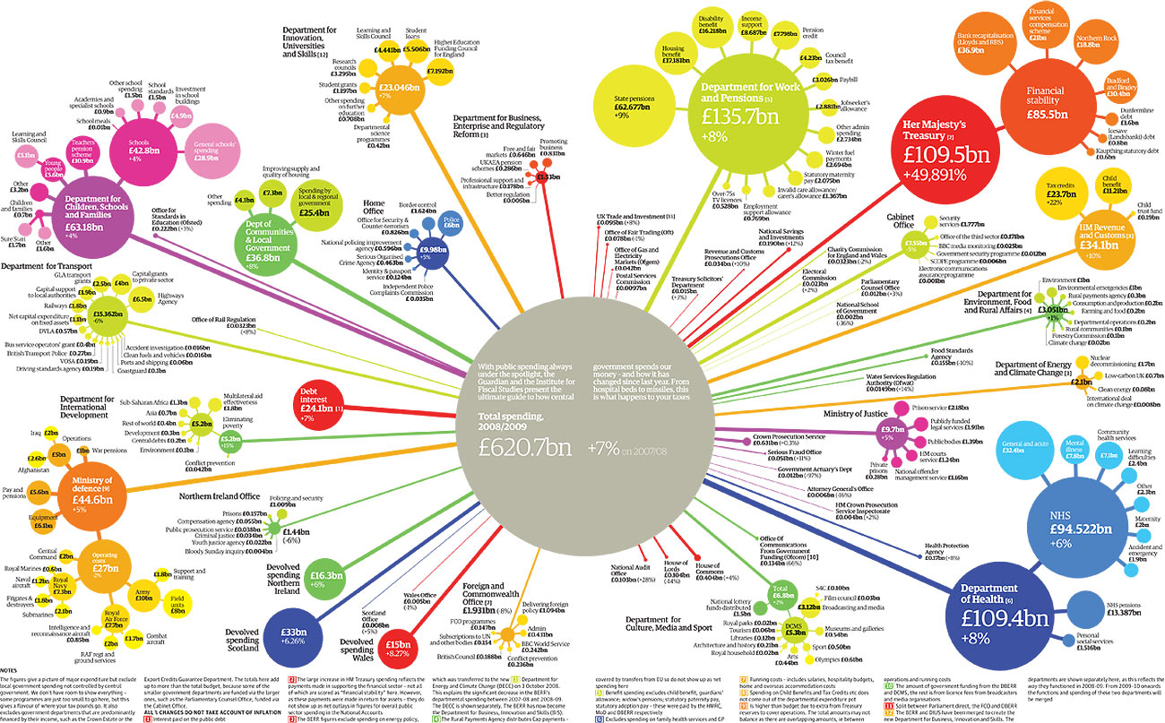
Research councils
Notes:
This is for a year earlier diagram produced by institute of fiscal studies for guardian each year shows where govt spending goes
Interesting that only a year earlier the interest on national debt (red circle due west of centre) was half that shown on previous slide - that is because of the orange circle (NE east of centre), the cash used to bail out the banks
BIS is orange-yellow circle NNE of centre – quite small, RCs are fourth satellite clockwise from base – not big
STFC not shown on here – but if it was we are about the size of the first circle (clockwise from base) which is the same size as the smallest satellite of Dept for work and pensions (yellow-green circle NNE of centre) which is the amount the govt spends on free TV licences for the over 75s
Message is we are very small beer – both financially and in terms of political headache
But silver lining we are irrelevant in producing savings
So if we can demonstrate our importance in rebalancing the economy
Delivering impact skills, jobs, inward investment etc
It is not too hard for them to give us a more generous settlement
Big but we are not the only ones saying that

Slide 4
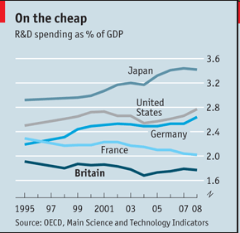
Notes:
4

Slide 5
Spending Review 2010 Timeline
BIS are in final negotiations with Treasury
Research Councils are continuing to iterate with BIS
Describing impact of various funding scenarios
Addressing specific requests
Final BIS allocation will be confirmed on October 20th as part of a public announcement of the SR outcome
BIS will then carry out their internal review
We may know the individual Research Council budgets by December? Earlier?
Notes:
The Spending Review is due to be published on Wednesday 20 October 2010 and will set out spending plans for the years 2011-12 to 2014-15.
The timetable for the review, the process and guiding principles that underpin the Government’s approach to setting spending limits are set out in the Spending Review Framework (available on HM Treasury’s website).
We should find out what share is allocated to the Research Councils in December / January.
5

Slide 6
Scenarios
 | Near cash | Capital
A | flat | -33%
B | -10% | -33%
C | -20% | -50%
Government’s targets are over four years and with respect to an inflating baseline, so their “25% reduction” is equivalent to a reduction of about 15% in cash terms
Notes:
6

Slide 7
Delivery plan status
Must address the 33% reduction in administration costs under all scenarios
Assuming that the STFC budget is partitioned into 3 areas; International subs, UK facilities, and core programme, and applying the scenarios separately to each area.
Assuming full international compensation for currency fluctuations and transfer of space programme to UKSA.
STFC Council CSR Planning Group developed delivery plan, taking input from Science Board.
Most recent information to BIS on 30 September; we are continuing to respond to questions and expect more “homework”

Slide 8
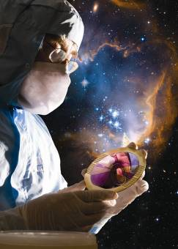
Why fund science in 2010?
Impact on the economy
recovery from recession, knowledge economy
Address the big challenges facing us and the world
energy, environment, healthcare and security
Notes:
8

Slide 9
To do this we need a long term vision
Young people must be attracted into STEM to underpin future workforce
role of inspirational science - particle physics, nuclear physics and astronomy
Access to world class research facilities and technology
Bringing researchers together across disciplines and connecting national laboratories, academia and industry
solutions to these cross-disciplinary challenges will not be found within any of these alone
Notes:
9

Slide 10
…and hence our plan for 2010-14
Funding clearly constrained for the next four years
But the importance of science is growing – scientific and technical innovation is increasingly key to our future prosperity, security and wellbeing
We need to find ways to maintain our scientific position on reduced funding levels without causing permanent damage to our long term prospects
Notes:
10

Slide 11
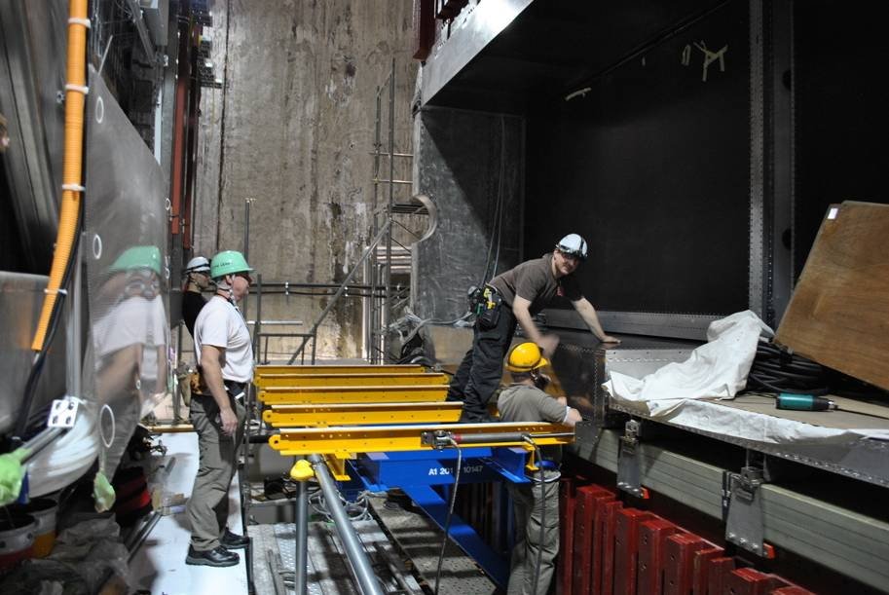
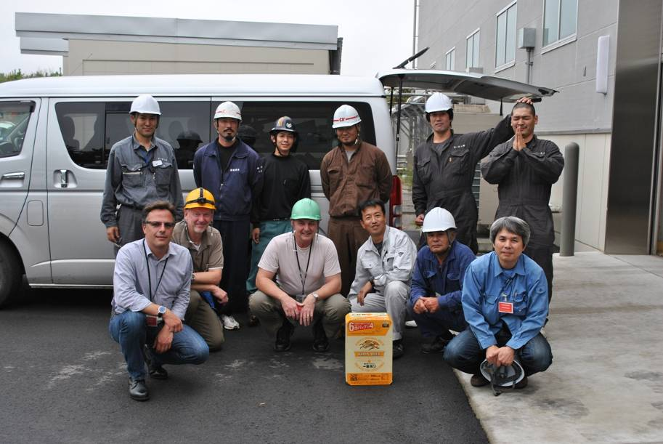
and do great science…
T2K barrel ECAL now installed in the ex-UA1 magnet at J-PARC
Notes:
11

Slide 12
Let’s assume our arguments are well received and we are successful in making the case
this might mean that STFC does better than the –25% average across government: what if we ended up with –15% for example?
We have therefore started to ask the research communities:
If we are still faced with serious and real reductions, what is your vision for this area of research?
Notes:
Consultation info on the external web under ‘What we do’ – ‘Spending Review 2010’
Look for more info. on the process and news on in.focus under ‘About’ – ‘Budget’
12

Slide 13
Some questions for today
Research concentration vs. maintaining national breadth (in support of undergraduate education)?
Physics is already concentrated: 80% of STFC funding goes to only 16 institutions
University institutes/consortia to maintain critical mass in strategic but vulnerable science areas
Nuclear Physics and Particle Astrophysics?
Importance of studentship training schemes?
Some kind of fellowships scheme to retain key talented researchers in UK?

Slide 14
Role of national laboratories
Greater complementarity (especially in areas such as particle physics) between technology role of labs and science exploitation role of universities
Concentration of research equipment at national laboratory sites
What capabilities (or technologies) have the greatest potential to contribute to the global challenges (health, energy, environment, security) and how best could these be exploited?

Slide 15
Grant Funding Mechanisms Review
Panel chaired by James Stirling reviewed grant funding mechanisms in PP, NP and A
Carried out consultation on three possible options
Panel’s recommended option takes account of consultation inputs and is not exactly any of the three options proposed
Will continue to allow for long term support for ongoing research efforts
Consistent with need for administration savings
a streamlined, simpler system
Recommendations presented to PPAN, goes to Science Board next week and Council later this month

Slide 16
discussion

Slide 17
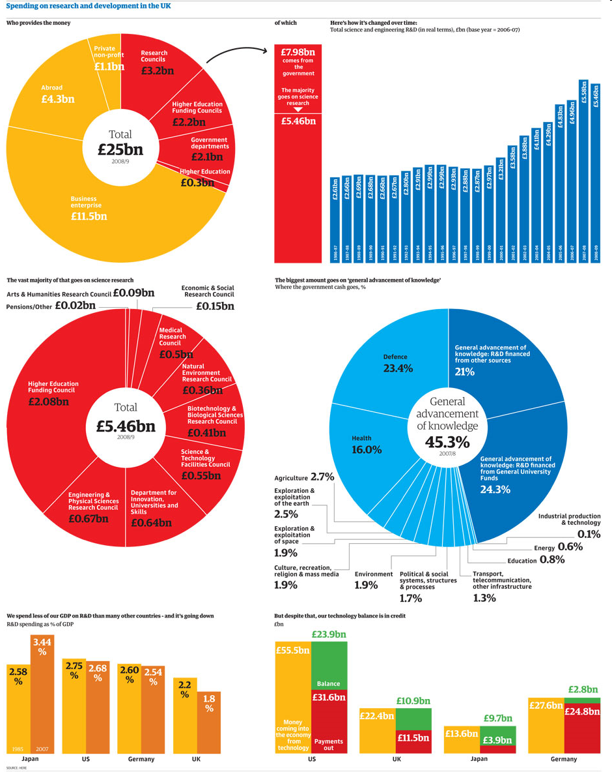
Notes:
17

