Slide 1
Issues for WG5, October 16th 2012
Michael Kobel: IPPOG Co-chair, TU Dresden

Slide 2
Who is IPPOG?
+ many associates

Slide 3
Relation to EPPCN
Good contact of many IPPOG country representatives to their EPPCN member (not all, improvement possible)
½ day common meeting each year gives good insight into mutual work
No real collaborational work so far due to
Different Target groups
→ existence of 2 separate groups is well motivated
nevertheless: EPPCN and IPPOG could build up on synergies
build common working groups on individual topics, where it makes sense
e.g. IPPOG WG „Do‘s and Dont‘s explaining the Higgs“
 | High Schools | General Public | Scientists | Media | Science Centres & Museums
IPPOG | ✔ | ✔ | ✔ |  | ✔
EPPCN |  |  | ✔ | ✔
Interactions |  | ✔ | ✔ | ✔
Quarknet | ✔
Aspera |  | ✔ | ✔ | ✔

Slide 4
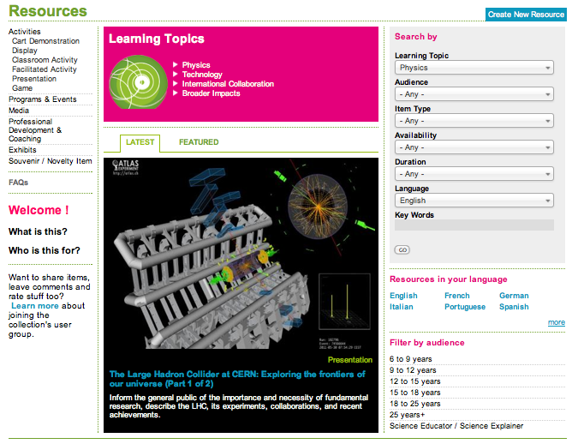
IPPOG activities, example #1: Education & Outreach Collection
http://ippog.web.cern.ch http://facebook.com/IPPOG

Slide 5
http://ippog.web.cern.ch/resources
What is it?
Collection of recommended tools and materials to be used in outreach
videos, brochures, posters, talks, exhibits ideas for hands-on activities and more.
Who is it for?
Collection for use by anyone engaged in particle physics outreach and informal education initiatives.
including informal science educators & explainers, and anyone else wishing to help others understand fascination of particle physics
What did it take ?
“leased” from CERN’s PATHWAY FP7 project:
Person for Technical setup and user interface:
Supported from CERN since mid 2010 til end 2012
50% FTE: for collect and fill database encouraging everybody else to do so, setting up and following up working groups (2 years)
20% FTE: for technical maintenance and improvements (1/2 year)
Medium / Long term support: not secured

Slide 6
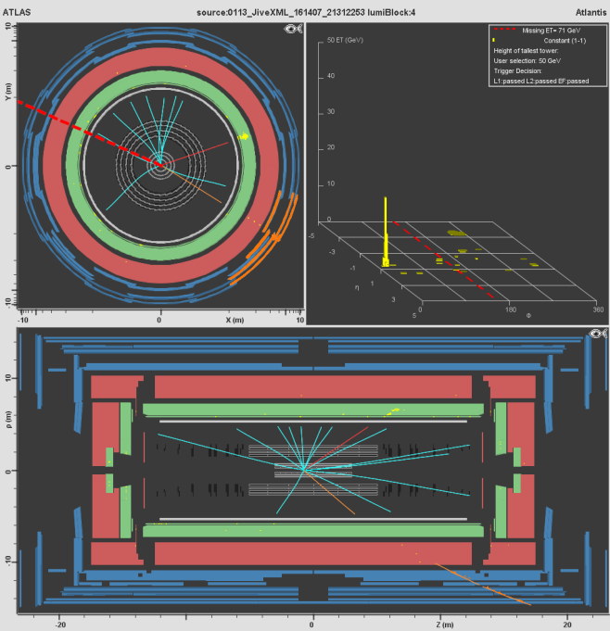
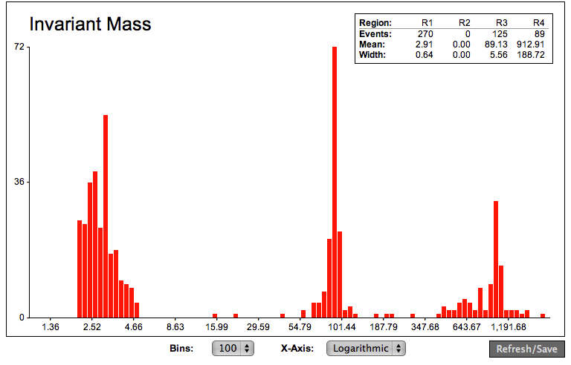
IPPOG activities, example #2: international Masterclasses
Particle Physics Masterclass
Target: 16-19 year-old students, teachers, public
Introduced and guided by scientists („masters“)
Work (in pairs) on real data from CERN
Classify ~ 100 particle collision images, each
Combine: compare abundance or plot spectra
Draw conclusions, get insights
Possible Masterclass (MC) Formats
Institute MC: 1 day at research institute
Original idea from UK, since 1996
International MC: moderated video conference
Organized since 2005 by IPPOG
Local MC: Ph.D. students bring data to venues
Since 2010 in German “Netzwerk Teilchenwelt”

Slide 7
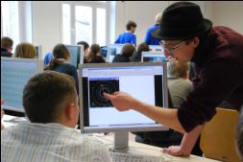
Aim: Authentic Science
Make public into scientists for a day
Active „hands-on“ involvement
hear = forget, see = remember, do = understand
boil down to essentials for enabling own measurements
As close as possible to current research
follow up what scientists have recently done
Get insight into research process
use original methods and tools
compare the results to theories
Authentic experience
Analyse real scientific data
Meet and discuss with active scientists

Slide 8
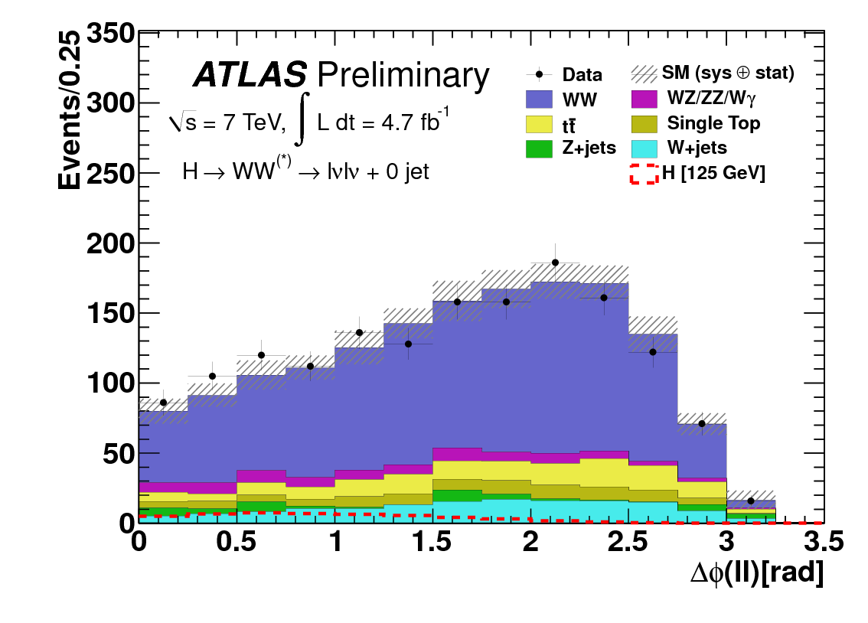
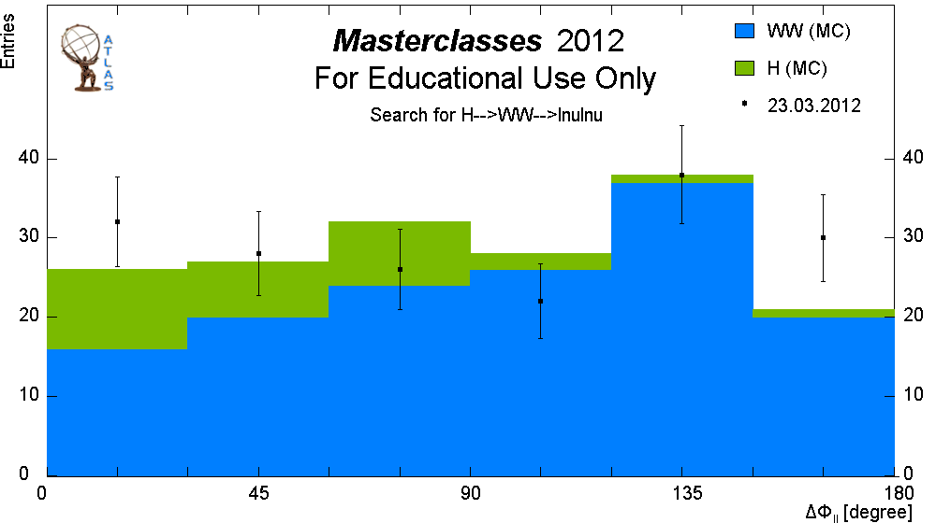
Measurement examples from CERN data
Basic insights
Why do p-p collisions produce more W⁺ than W ⁻ ? → Proton structure !
2 u-quarks: positive electric charge -> emit W⁺
1 d-quark: negative electric charge -> emit W⁻
Cutting edge research: Higgs → W⁺ W⁻ → l⁺ν l⁻ν

Slide 9
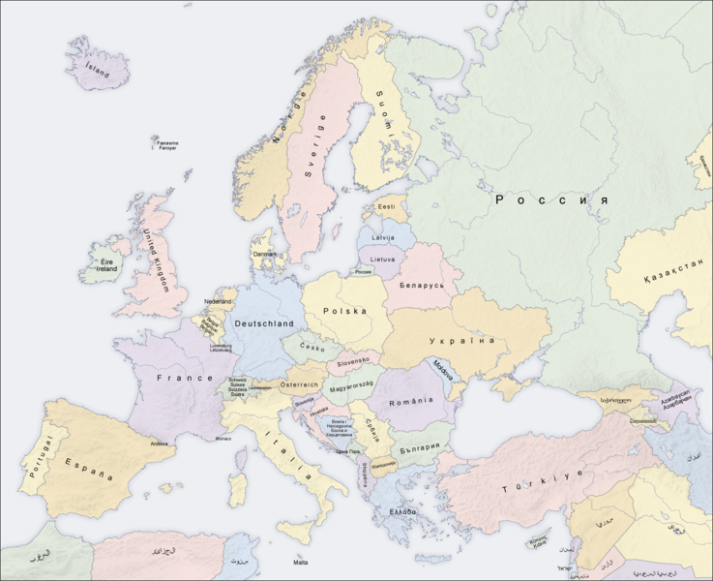
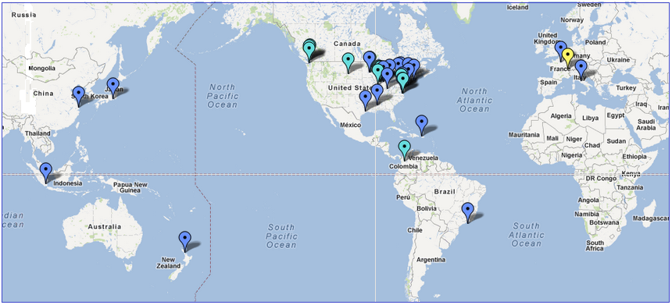
International Masterclasses in 33 countries
Each year 4 weeks in spring, next 25.2. – 22.3.2013
www.physicsmasterclasses.org
Notes:
Zahlen von 2012

Slide 10
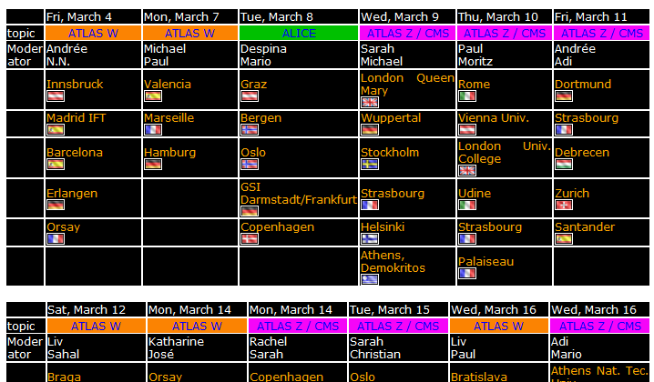
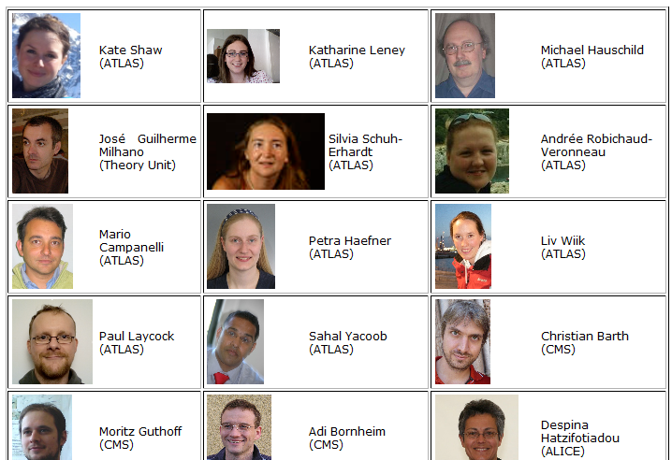
Example Schedule
www.physicsmasterclasses.org/index.php?cat=schedule …
Lots of friendly engaged young video conference moderators

Slide 11
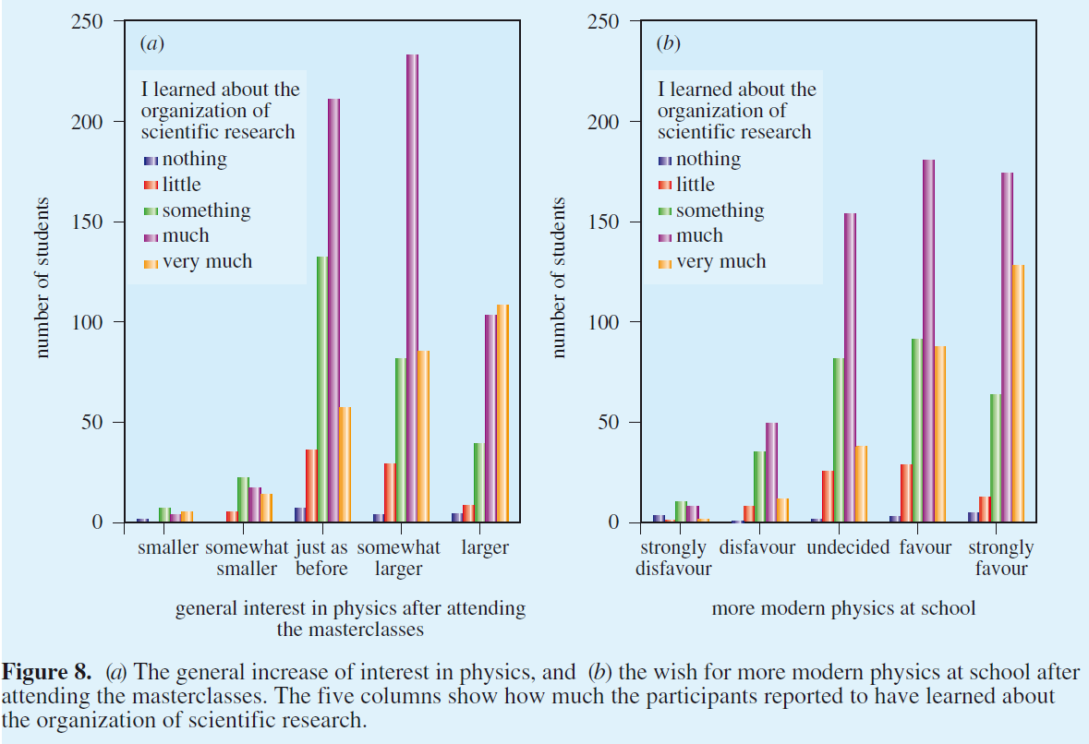
Evaluation in Physics Education 42 (2007) 636

Slide 12
Funding of International Masterclasses
Central Organisation for IPPOG:
Project Coordination Europe / Africa / Asia (west)
Coordinator: Helmholtz Alliance Germany (since mid 2008) , CERN (from 2013)
Infrastructure and student assistents: TU Dresden
Project coordination America / Australia / Asia (east): US-Quarknet
In-Kind
Personnel: IPPOG, CERN-IT EVO/Vidyo team Many local institutes (Athens, Birmingham, Dresden, Oslo, …)
Prizes: CERN
CDs, Brochures: EPS + national resources
Upgrade for LHC data: 2010-2012
Personnel in ATLAS, CMS, ALICE
Didactic Ph.D. student: German Wolfgang-Gentner program @ CERN
Technical support and trials: German BMBF LHC communication project

Slide 13
Possible new future IPPOG roles?
To be shaped by new chairs from 2013
Some options:
Expanding internationally (2012: Romania, Ireland, … )
Spreading programs and experiences
Role model of existing sucessful national networks
Quarknet (US, teachers)
Netzwerk Teilchenwelt (DE+CERN, teachers and students)
…
New support structures
Building Portable Cosmic ray experiments at CERN?
Beamline for students‘ measurements at CERN?
…
Will depend on funding

Slide 14
3 IPPOG funding eras
Before mid 2008: ~zero funding
individual personal efforts,
e.g. international masterclasses (IMC) with existing LEP data: M.K.
Mid 2008 – today: patchwork funding
IMC and upgrade for LHC:
Various in-kind contributions from institutes and CERN
German Helmholtz Alliance, Gentner and Research ministry
Database and IPPOG organisation
Synergy with other projects (PATHWAY)
50% FTE for two years from CERN
Future: to be secured (by new chairs from 2013 !)
50% FTE for International MC coordination (CERN: 2013 - … ?)
50% FTE for IPPOG coordination, database, working groups, …
10-20% FTE technical support
Printing costs flyers, DVDs, travel, etc

Slide 15
SUMMARY:
IPPOG is an established successful outreach and education structure
ready to be intergrated into the European Strategy Process

